Slide 1
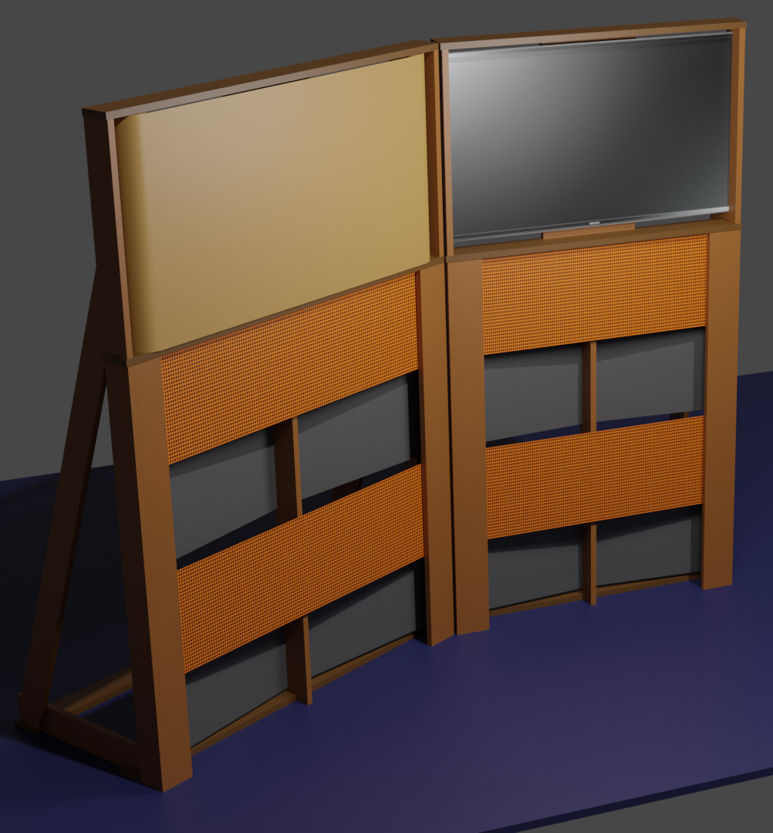
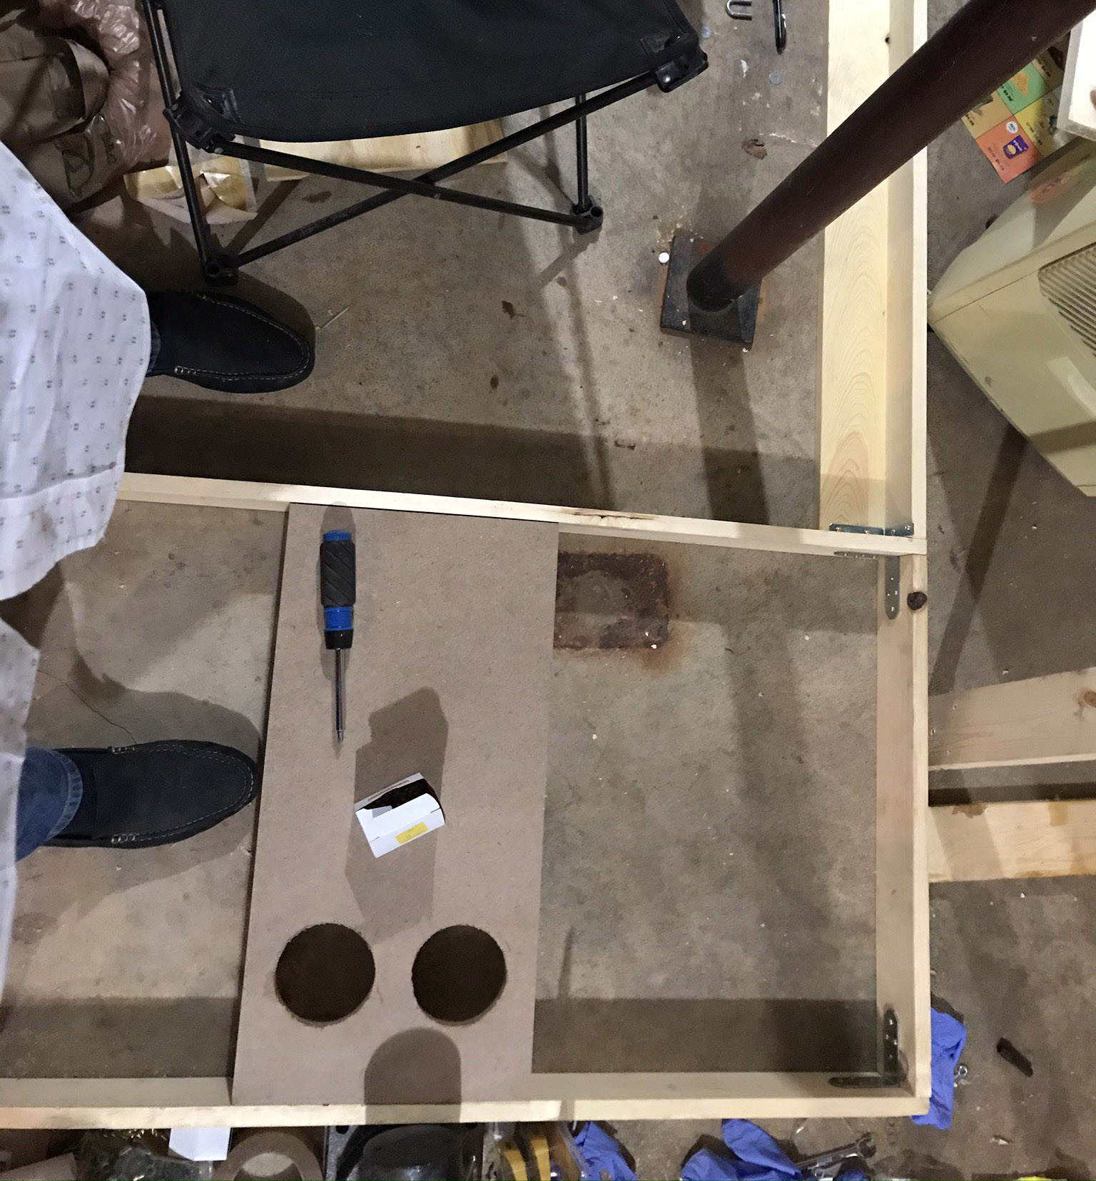

Slide 2
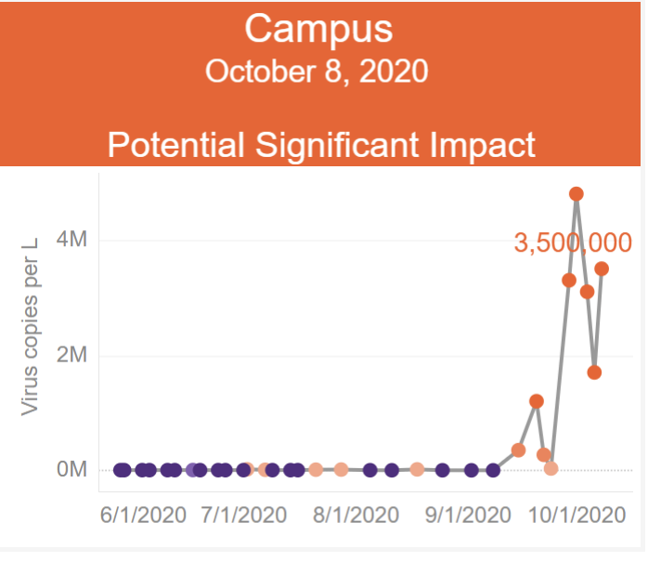
One 10/8 report: of 1712, #2 in cum case count (#1 had ~twice as many students)

Slide 3
Condition Variables
a way for one thread to wait for another thread to take some action.
a web server might wait until a new request arrives;
a word processor might wait for a key to be pressed (although, events);
a weather simulator’s coordinator thread might wait for the worker threads calculating temperatures in each region to finish; ..
In all of these cases, we want a thread to wait for some action to change the system state so that the thread can make progress.

Slide 4
Condition Variables
One rationale: safe synchronization while avoiding:
Busy-waits/loops
Sleeps

Slide 5
Condition Variables
One rationale: safe synchronization while avoiding:
Busy-waits/loops
inefficient: the waiting thread continually loops, or busy-waits, consuming processor cycles without making useful progress.
Worse, busy-waiting can delay the scheduling of other threads — perhaps exactly the thread for which the looping thread is waiting.
Re deadlocks, ch6
Sleeps

Slide 6
Deadlock
Resource: any (passive) thing needed by a thread to do its job (CPU, disk space, memory, lock)
Preemptable: can be taken away by OS
Non-preemptable: must leave with thread
Starvation: thread waits indefinitely
Deadlock: circular waiting for resources
Deadlock => starvation, but not vice versa
Notes:
(disk space -- what would you think if I took space for your files?)
(mutual exclusion is a weird kind of resource!)

Slide 7
Preventing Deadlock
Exploit or limit program behavior
Limit program from doing anything that might lead to deadlock
Predict the future
If we know what program will do, we can tell if granting a resource might lead to deadlock
Detect and recover
If we can rollback a thread, we can fix a deadlock once it occurs

Slide 8
Condition Variables
One rationale: safe synchronization while avoiding:
Busy-waits/loops
Sleeps
“We often find that students want to “fix” the polling-based approach by adding a delay…
“we could add a call to sleep to yield the processor for (say) 100 ms after each unsuccessful tryRemove call.
two problems.
although it reduces the inefficiency of polling, it does not eliminate it.
periodic polling adds latency.
Example: Measurements of the server showed surprisingly bad performance; we expected each request to take a few milliseconds, but instead each took just over half a second.
Fortunately, the performance was so poor that it was easy to track down the problem: layers passed work to each other through bounded queues much like TSQueue, but the queue remove method was implemented as a polling loop with a 100 ms delay.

Slide 9
Condition Variables
Waiting inside a critical section
Called only when holding a lock
Wait: atomically release lock and relinquish processor
Reacquire the lock when wakened
Signal: wake up a waiter, if any
Broadcast: wake up all waiters, if any
“WARNING: Note that condition variable wait and signal are different from the UNIX system calls wait and signal. The nomenclature is unfortunate but longstanding. In this book, we always use the terms, UNIX wait and UNIX signal, to refer to the UNIX variants, and simple wait and signal to refer to condition variable operations.”

Slide 10
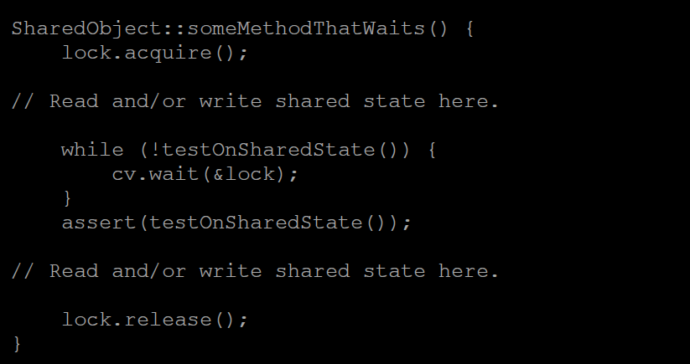

Slide 11
Condition Variables, cont’d
When a thread is woken up from wait, it may not run immediately
Signal/broadcast put thread on ready list
When lock is released, anyone might acquire it
Wait MUST be in a loop
while (needToWait()) {
condition.Wait(lock);
}
Simplifies implementation
Of condition variables and locks
Of code that uses condition variables and locks

Slide 12
“Remember the rules”
Use consistent structure
Always use locks and condition variables
Always acquire lock at beginning of procedure, release at end
Always hold lock when using a condition variable
Always wait in while loop
Never spin in sleep()

